Slide 1
Enagás, REnagás, REN and TIGF
EN and TIGF
IT implementation plans and agreements with PRISMA
25th IG meeting
13th December 2013

Slide 2
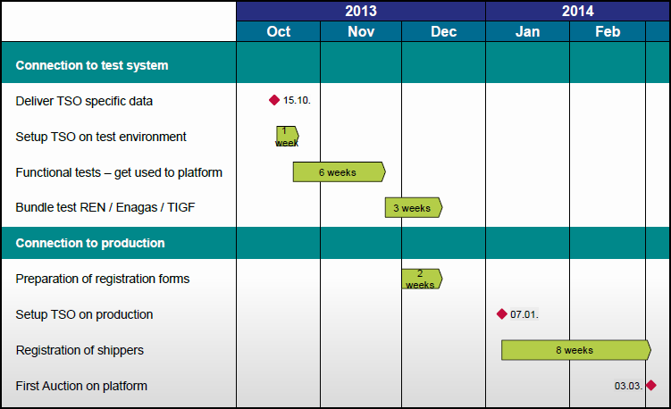
1. Test system
At mid-December, IT Implementation is on going.
Deadlines should be fulfilled.

Slide 3
2. Test system
Functional test for Enagás and TIGF: (28th October – 25th November)
  Enagas and TIGF upload points
  Enagas and TIGF create unbundled points
  Enagas and TIGF create shippers
  Enagas and TIGF create unbundled auctions
Bundled test ENAGAS/TIGF: (25th November – 15th December)
  Enagas/TIGF upload points
  Enagas/TIGF create bundled points
  Enagas/TIGF approve shippers from the other TSO
  Enagas/TIGF create bundled auctions
+Bundled test ENAGAS/REN: (25th November – 15th December)
    Pending creation bundled points

Slide 4
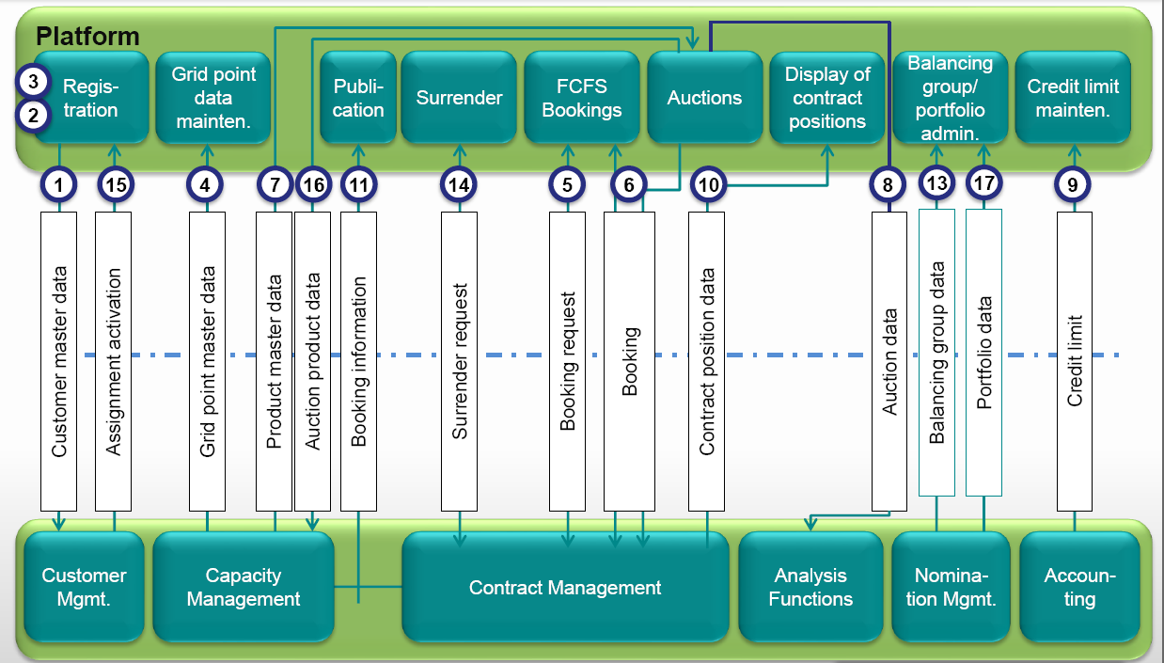
3. Enagas Project Scope: Interfaces to be implemented
√
√
√
√
√

Slide 5
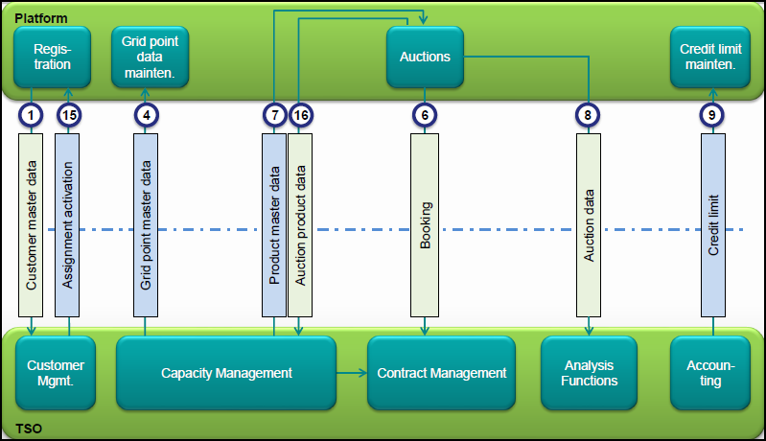
3. TIGF Project Scope: Interfaces to be implemented

Slide 6
4. Enagas Planning: Main tasks and milestones
We must assess the need for joint tests of the TSOs involved and PRISMA
2013
2014
Project: Sept-2014 CAM-CMP Implementation
Q1
Q2
Q3
Q4
Q1
Q2
Q3
Q4
Kick-Off
09/07
Functional Requirements
Requirements approval
15/11
Technical analysis and development
Testing Plan
FAT/SAT Testing
Go Live
10/09

Slide 7
5. Key points to manage
Common Functional Scope
Common Project Testing Plan
Testing environment in PRISMA
Training Sessions with Shippers

Slide 8
5. Stakeholder PRISMA training
Training sessions for stakeholders is going to be held on the 9th January
It would be possible a new training session

